Slide 1
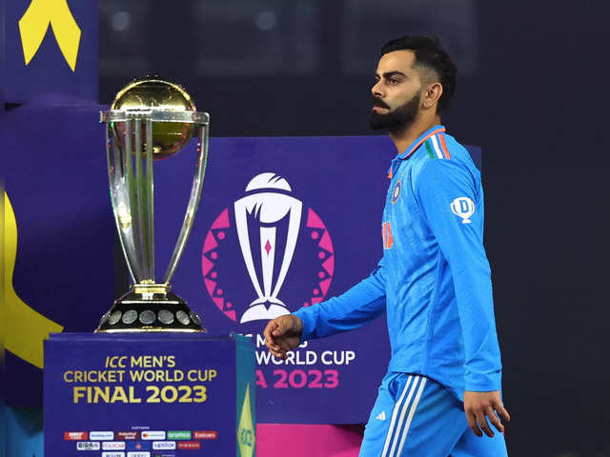
World Cup 2023 Analysis
-Presented by Jagruti Yewale

Slide 2

Objective
The objective of the World Cup 2023 analysis project using machine learning is to extract actionable insights from vast amounts of cricket data. By employing ML algorithms, the project aims to identify patterns, trends, and performance indicators to enhance team strategies, predict match outcomes, and provide valuable insights for coaches, analysts, and stakeholders in the cricket community.

Slide 3
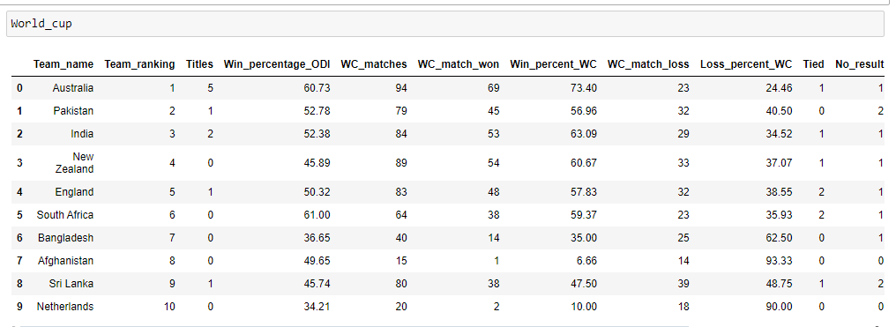
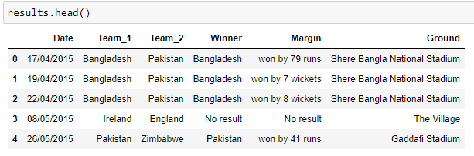
About Dataset
In [4]:

Slide 4
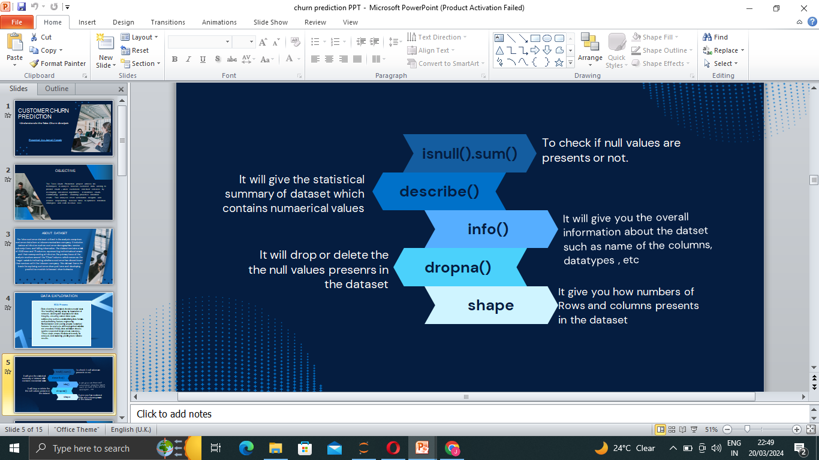
Preprocessing Dataset

Slide 5
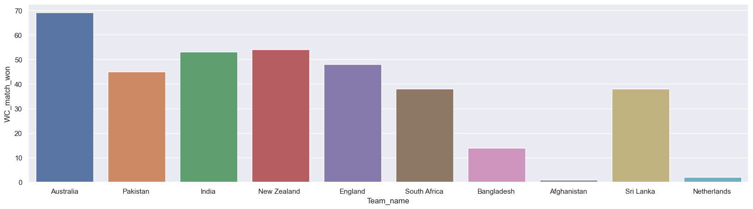
Visualization- No.of matches won in world cup by each team

Slide 6
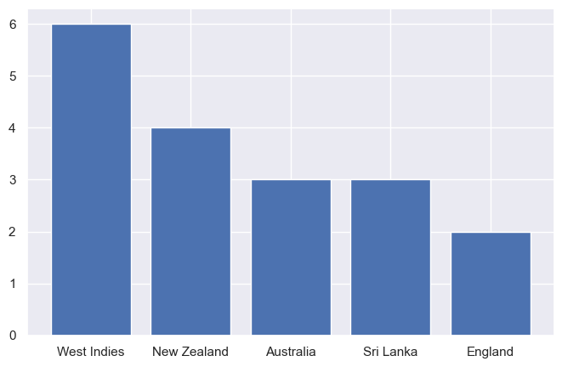
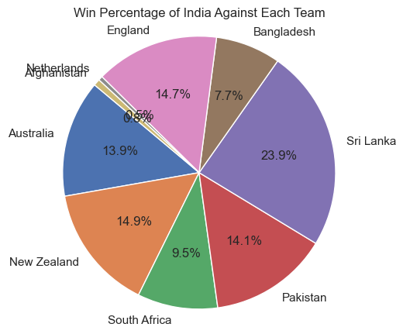
Stats of some top teams in the ODI WorldCup 2023 1.Stats of India team

Slide 7
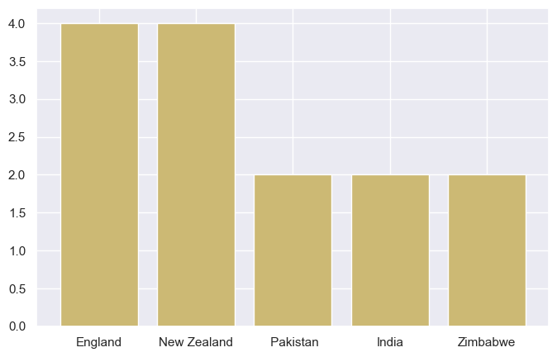
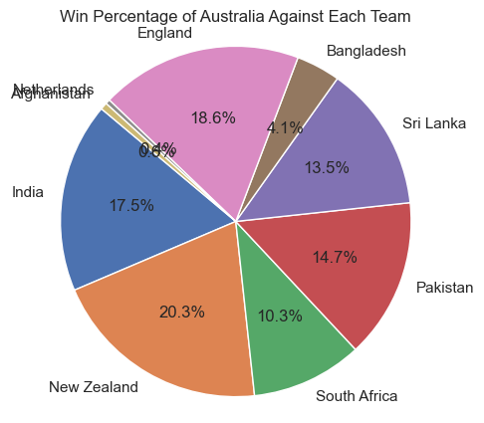
2.Stats of Australian team

Slide 8
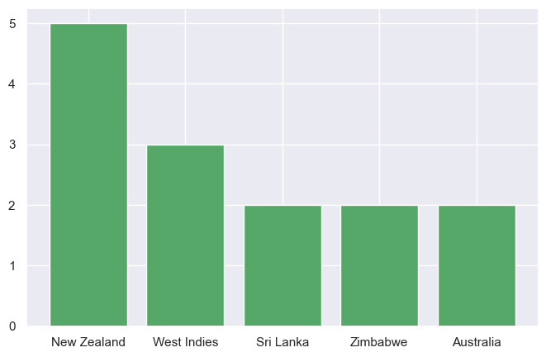
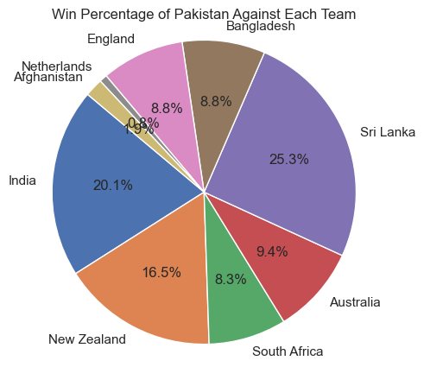
3.Stats of Pakistan team

Slide 9
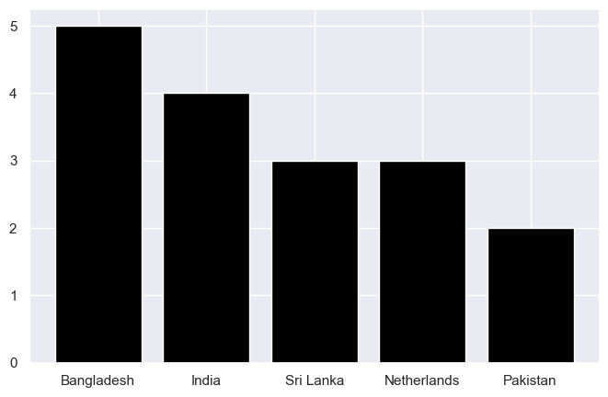
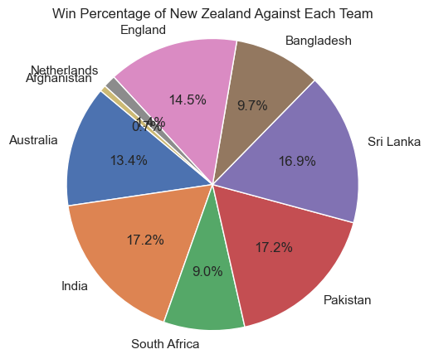
4.Stats of New Zealand team

Slide 10
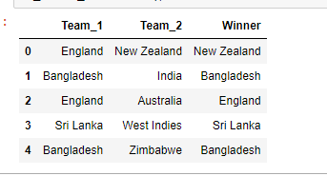
Processed Dataset

Slide 11
Model Building
Random Forest Classifier
An ensemble learning method that builds multiple decision trees during training and combines their predictions to improve accuracy and reduce overfitting.
It operates by averaging the predictions of individual decision trees to produce a final output.
Model Evaluation-
Training Accuracy - 74.90 %
Testing Accuracy – 67.56 %

Slide 12
Insights
In 2023, Australia emerged victorious, winning the ICC Cricket World Cup. They demonstrated exceptional performance throughout the tournament, culminating in their victory in the final match.
In the 2023 ICC Cricket World Cup, several countries performed exceptionally well. Alongside the champion Australia, teams like India, England, New Zealand, and South Africa showcased strong performances, reaching significant stages of the tournament and contributing to its excitement.
The 2023 ICC Cricket World Cup was marked by thrilling matches, record-breaking performances, and unforgettable moments. One of the best aspects was the high level of competition among teams, with close matches and unexpected upsets keeping fans on the edge of their seats throughout the tournament. Additionally, the emergence of young talent and the display of sportsmanship were noteworthy.

Slide 13
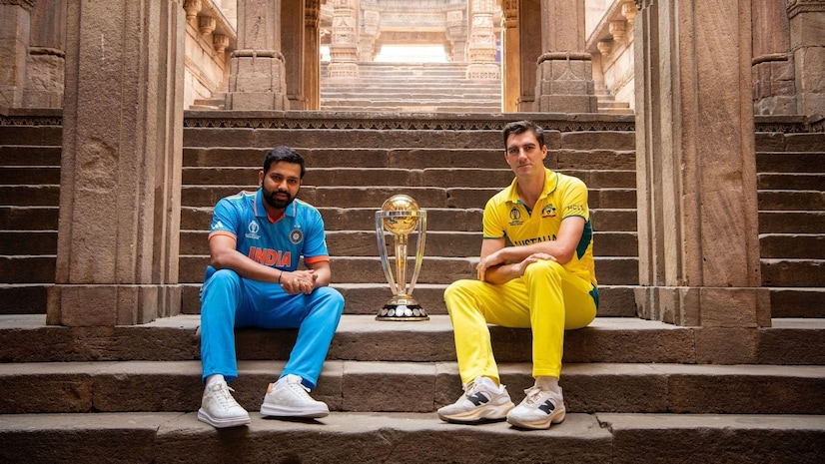
Conclusion
The World Cup 2023 analysis project applied machine learning to predict match outcomes and assess team performance. Utilizing a Random Forest Classifier, it analyzed historical data, providing insights into top teams' strengths, predicting match results, and offering semifinal probabilities. This approach enhanced strategic planning and understanding of cricket dynamics.

Slide 14
Thanks For Watching…

